Slide 1
Substance Abuse
Automate It
Team 630

Slide 2


Database Hierarchy
RDB
Login Credentials
Admin
C
Doctors Table
Insurance Contracts
Insurance Company Table
Doctor Metadata
Login Credentials
Patient Records
Patient Table
C
Company 1
Company 2
Company 3
MC
Patient Metadata Table
Doctors
Patients
Login Credentials
Patient Medication Table
Patient Log Journals Table
Reminders
Pre Admission Tasks
Medication

Slide 3
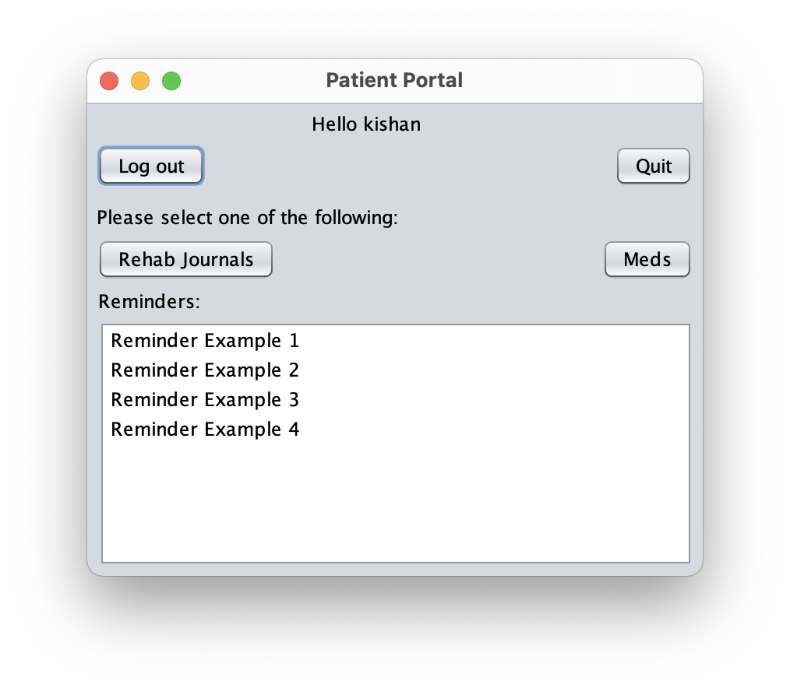
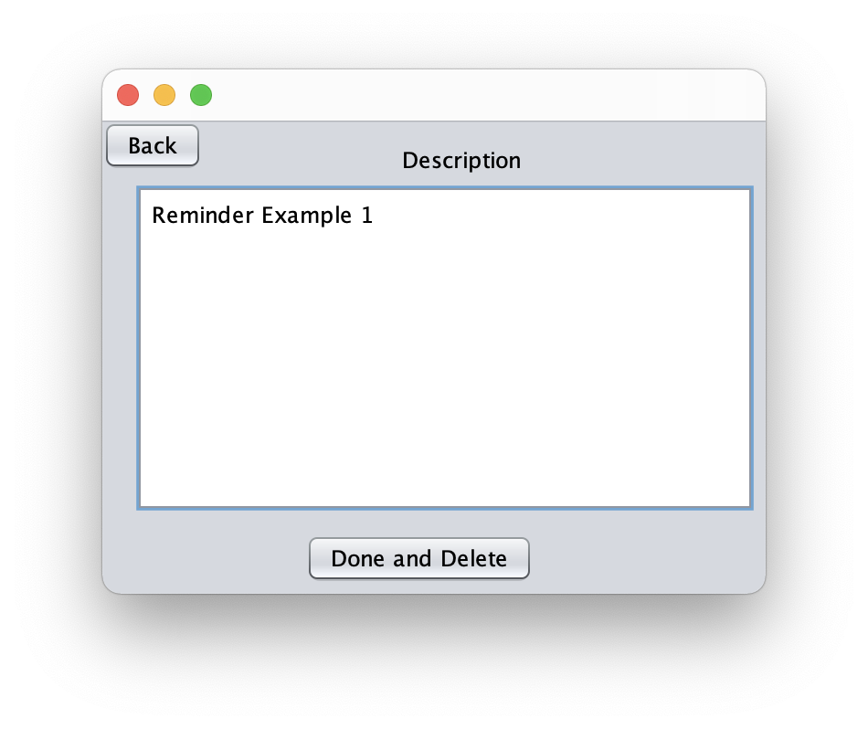
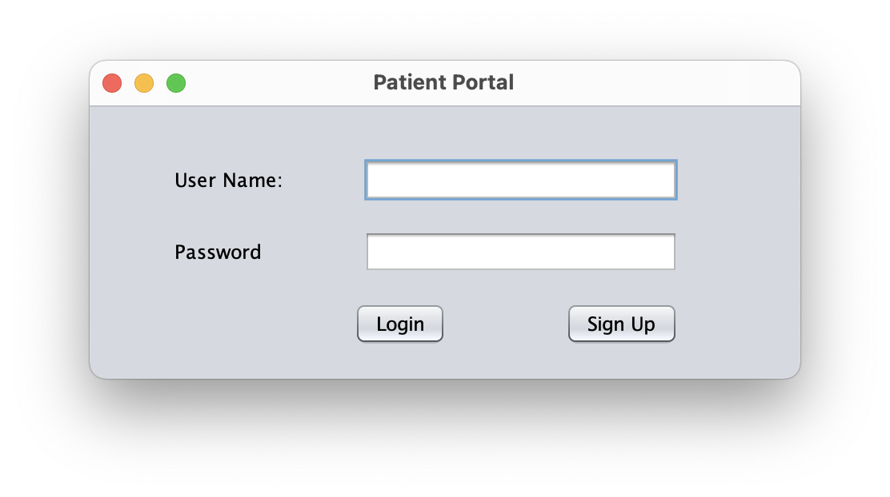
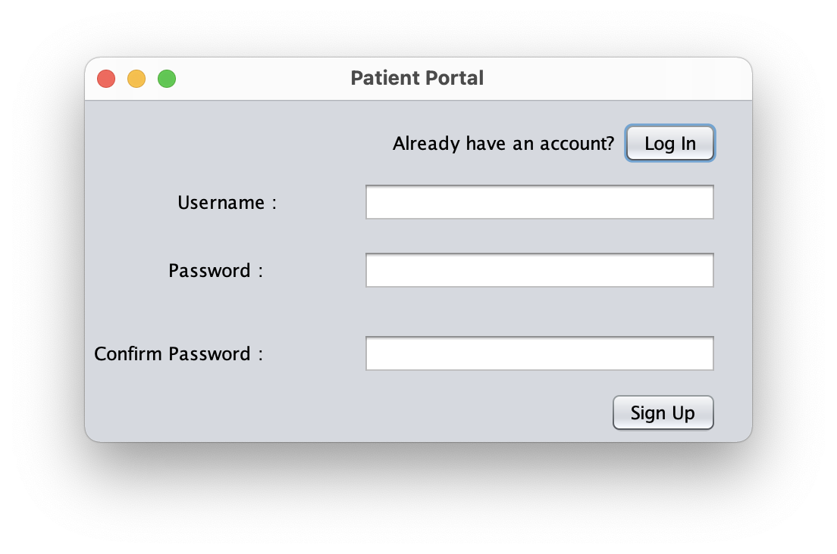
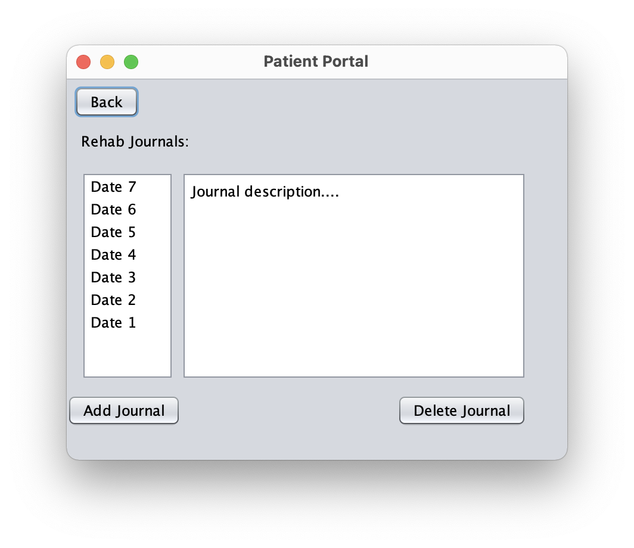
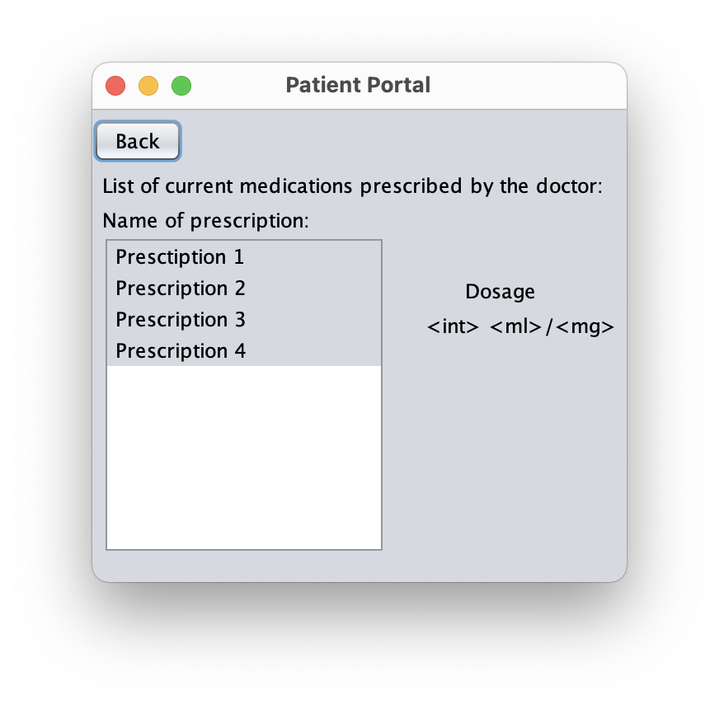
Patient’s App

Slide 4
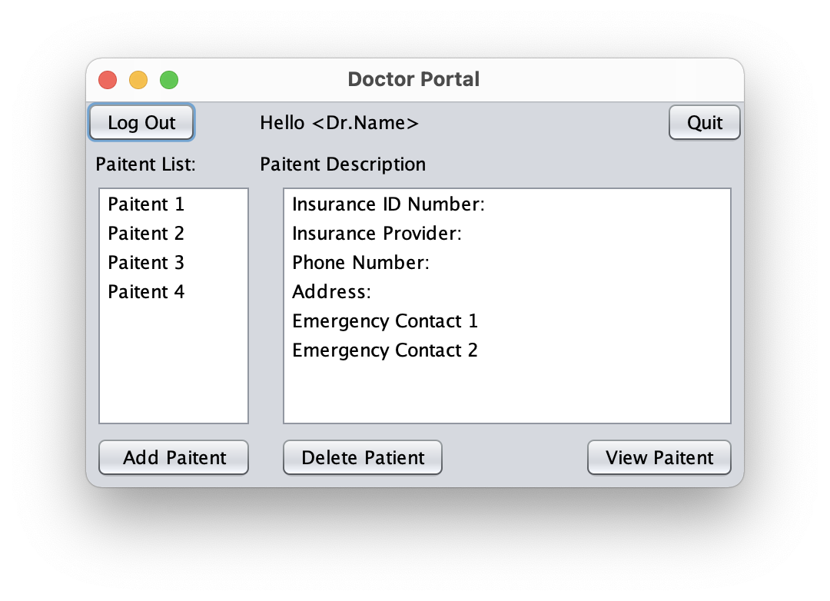
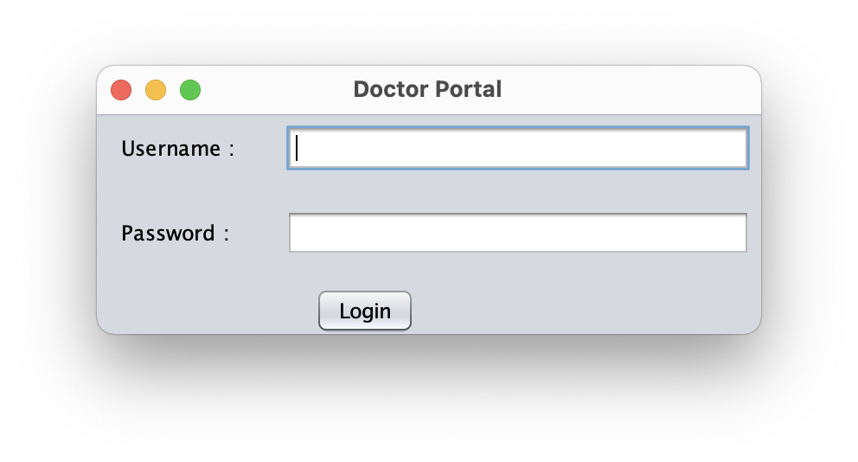
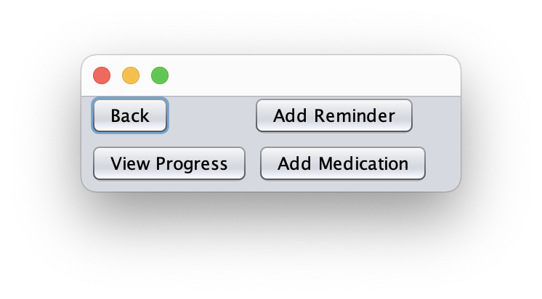
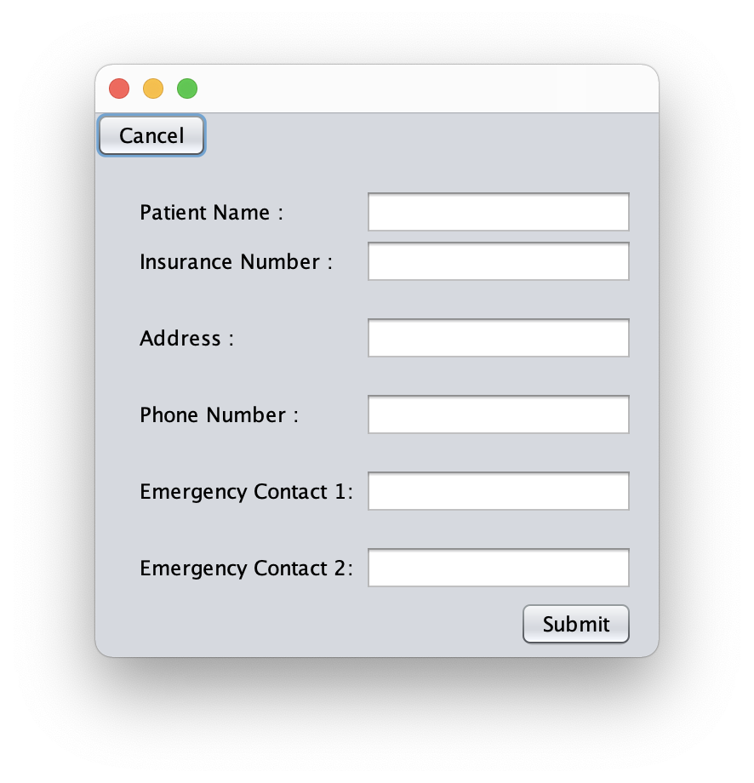
Doctor’s App
Add Medication of the Patient
Automatic reminder
Add reminders and
pre-check in tasks
Access Patient Rehab Journal
Automated task which will be
directly sent back to the doctor
once its completed on the
patient’s app.

Slide 5
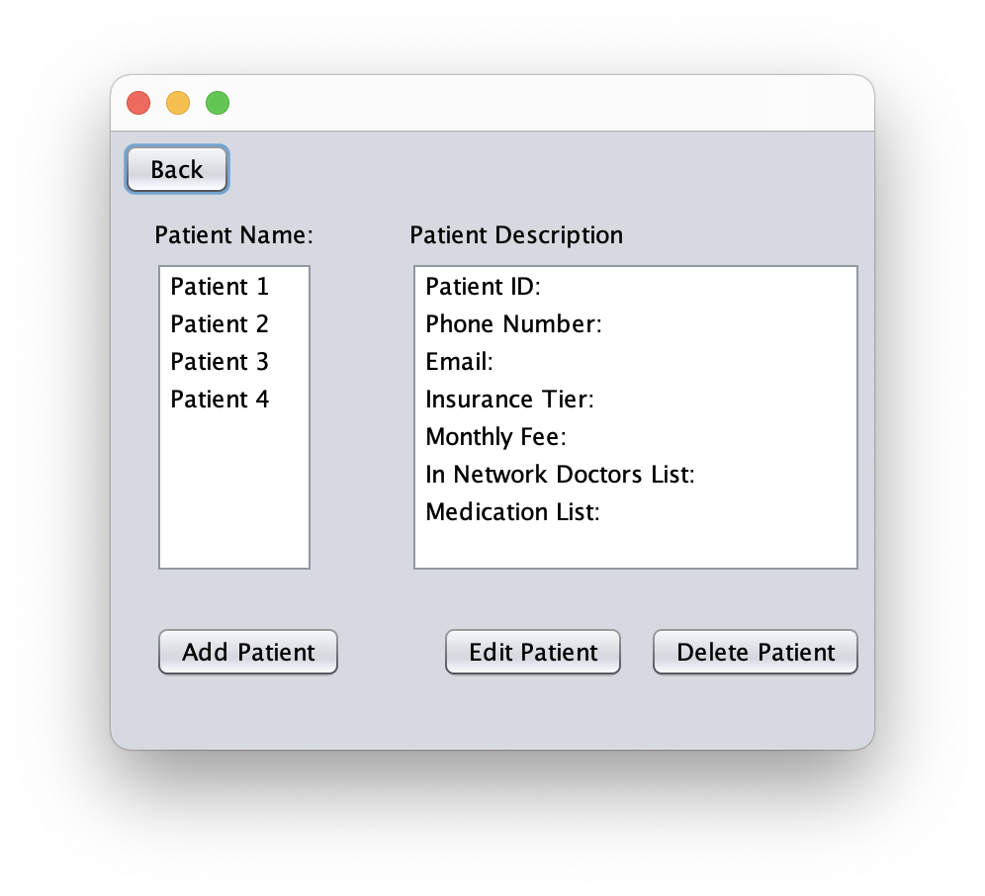
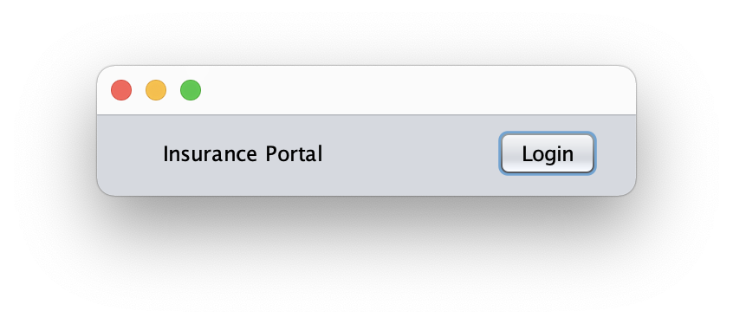
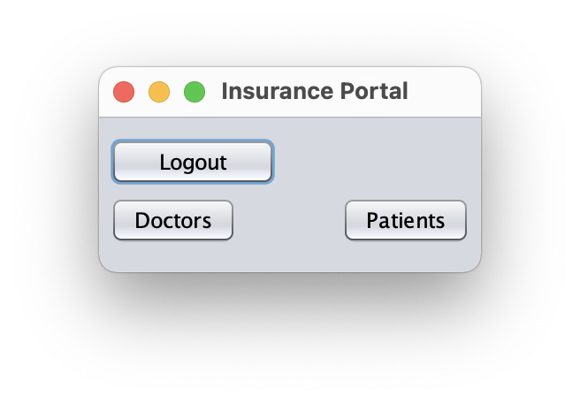
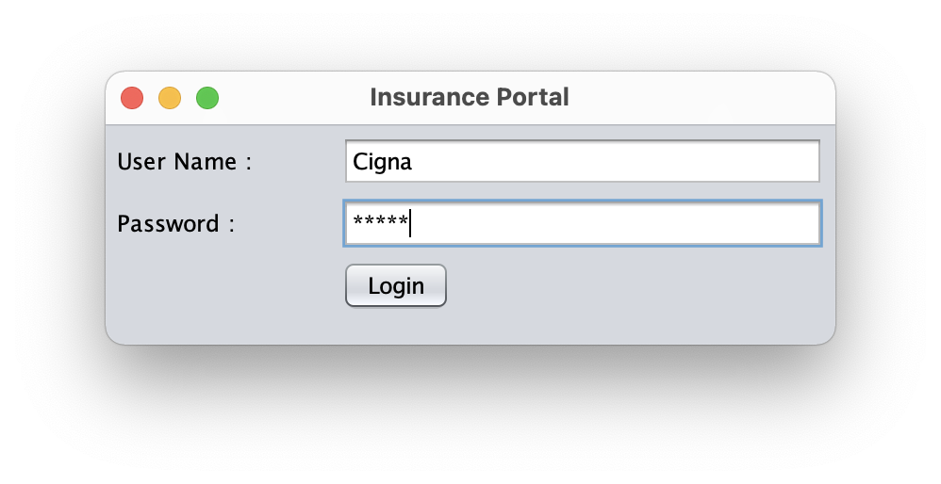
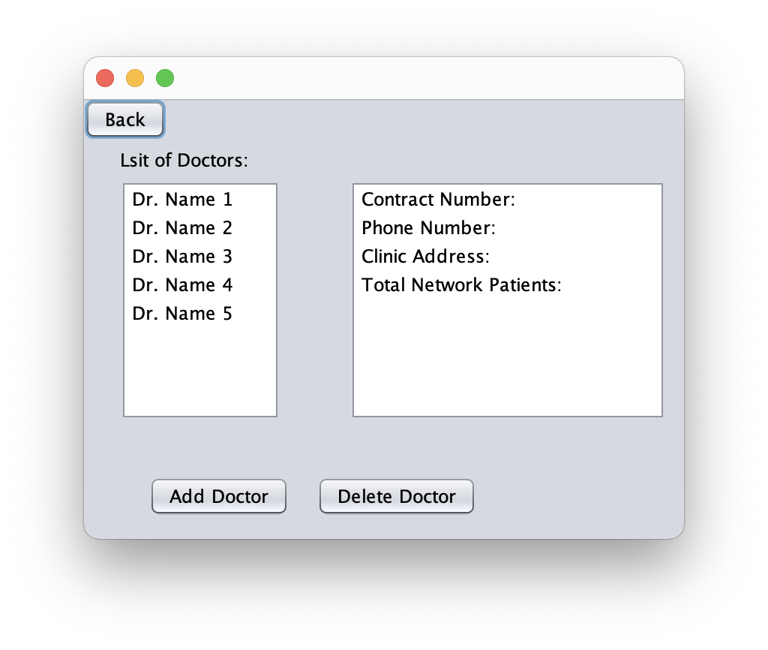
Insurance’s App
Add patient and
patient metadata
Metadata automatically updates
as doctors and medication is added
on both doctor’s and patient’s App
Add doctor and
doctor metadata

Slide 6
A second problem, solving the spread of misinformation
Automate It
Team 630

Slide 7
Automated News Filtering App
Flask app that scrapes websites for article information using html tags
Passes lists of article data to a function that uses sklearn to perform a passive aggressive strategy (passive-if prediction is correct don’t change, aggressive –if prediction is incorrect change the model) over a dataset
If the machine learning model finds enough similarities with unreliable news sources it return 0, else it return 1

Slide 8
Automated News Filtering App (cont.)
The title of the article is placed in a transient relationship and encoded using text vectorization
The article information is displayed dynamically in the html of the page based on whether it passes the test or not
A download link for the patient form is available as well

Slide 9
Thank You
Ammentorp, Max
Bhakta, Kishan
Lanctot, Joshua
Pathapati, Venkat
Schall, Michael

